Slide 1


Family Psychoeducation Educational Workshop

Slide 2
A NOTE FOR FACILITATORS - preparation
This is a template of a presentation that is not to be used as is. It is an example of how an early psychosis intervention team could structure their Workshop with participants, family members and supports. Please customize this PowerPoint with your program name and information as well as adding the EASA statewide logo and website if you are with an EASA program.
  To do this easily press Ctrl+F, type EASA in the search box, choose the “find and replace option” and type your program name in. Be sure to go through and review that everything changed correctly but this will make the process much easier for you!
Refer to the 'Core Content Areas’ in the EASA Practice Guidelines & Fidelity Assessment Tool (2026) and then edit and customize this example to meet your specific audience needs. This presentation is intended as a template for you to build upon and tailor for your specific program's educational workshop.
Throughout the slides you will find some with notes for presenters that are bold and italicized. Ensure you review those and edit as directed. You will also see some comments in the “Presenter Notes” section at the bottom of your screen that will provide direction for that section or slide.
Identify the format and agenda your team will use to share this information
Provide printed presentation with space for families to take notes. The printed slides may also be used as a psychoeducation “manual” to review section-by-section with single families who are unable to attend the group workshop
All team members should have an active role in sharing information throughout the workshop

Slide 3
A NOTE FOR FACILITATORS - presentation
Ensure you offer breaks and opportunities for people to mingle and connect with each other
Include time for questions at the end of each section
Find a balance of information to not overwhelm people, and ensure this is a casual space to interact and learn. Ensure you are covering information on clinical high risk for psychosis, schizophrenia spectrum disorders, and bipolar disorder with psychosis in your presentation. You may also want to provide information about other diagnoses as relevant to your specific audience.
Encourage families to take notes of their questions about their own experiences (i.e., this time is for the group, not for just one person’s experience). Reflection and journal sheets are provided in the 360Learning Module.

Slide 4
Agenda
PRESENTERS: Add in break times, or separate into sections for multiple sessions
Introductions/Icebreaker
Meet Your Team
Common Symptoms and Experiences
Causes and Things that Effect Psychosis
Common Diagnoses
Recovery and Personal Understanding of Psychosis
Typical Developmental Stages and Psychosis
EASA Principles
What can EASA do for you?
Crisis Management
Participant/Family Member/Graduate Panel
Understanding Privacy
Family Engagement and Common Experiences
Communication Tools and Tips
Breakout Groups
Problem-Solving Model
Resources/References

Slide 5
Goals for Today
Meet your team and participants/family members/supports in the program
Learn about symptoms, diagnoses, medications, and recovery in relationship clinical high risk for first episode psychosis
Learn about typical developmental stages for adolescents and youth/young adults
Understand the team-based treatment approach
Empower participants and families through shared information, knowledge, and connection
Sign up to participate in Multi-Family Group or Single-Family Sessions

Slide 6
Icebreaker/Discussion
PRESENTER NOTES/IDEAS:
Activity ideas:
  Get creative – find something that is engaging and accessible for participants. Consider your audience and location – if you have space and ability to move around, feel free to use that! If virtual, try to find an activity that encourages engagement even when the group is not in one room.
  https://www.sessionlab.com/blog/icebreaker-games/
  https://weand.me/2024/09/03/no-prep-icebreakers-for-adults/
Consider asking participants what they are hoping to get out of the workshop. When they answer, refer to different sections coming up on the agenda that will relate to their concerns, or write down questions that you may want to go more in depth with later in the workshop. This can include questions for the lived experience panel that you gather ahead of time and share with the presenters.

Slide 7
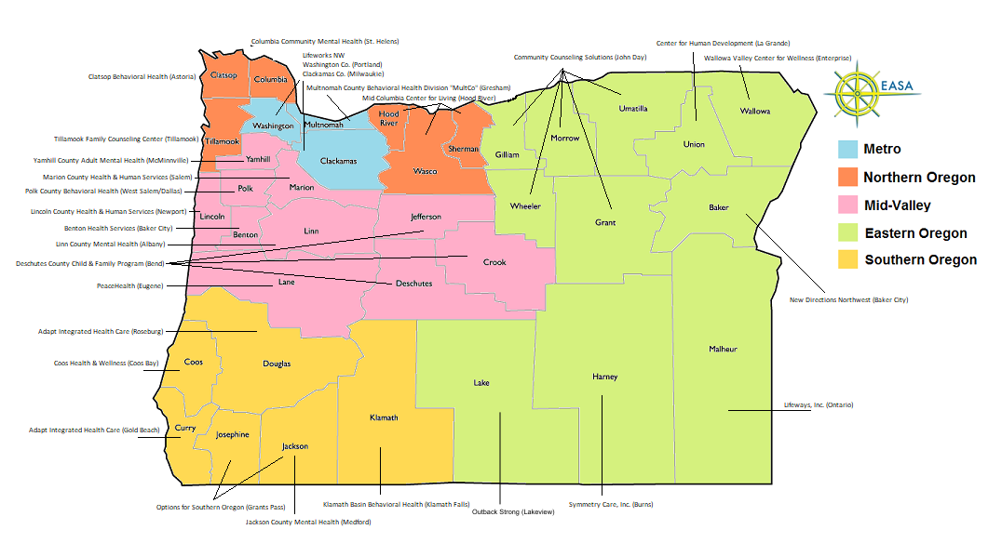
Oregon EASA Teams

Slide 8

Kentucky iHOPE Teams

Slide 9
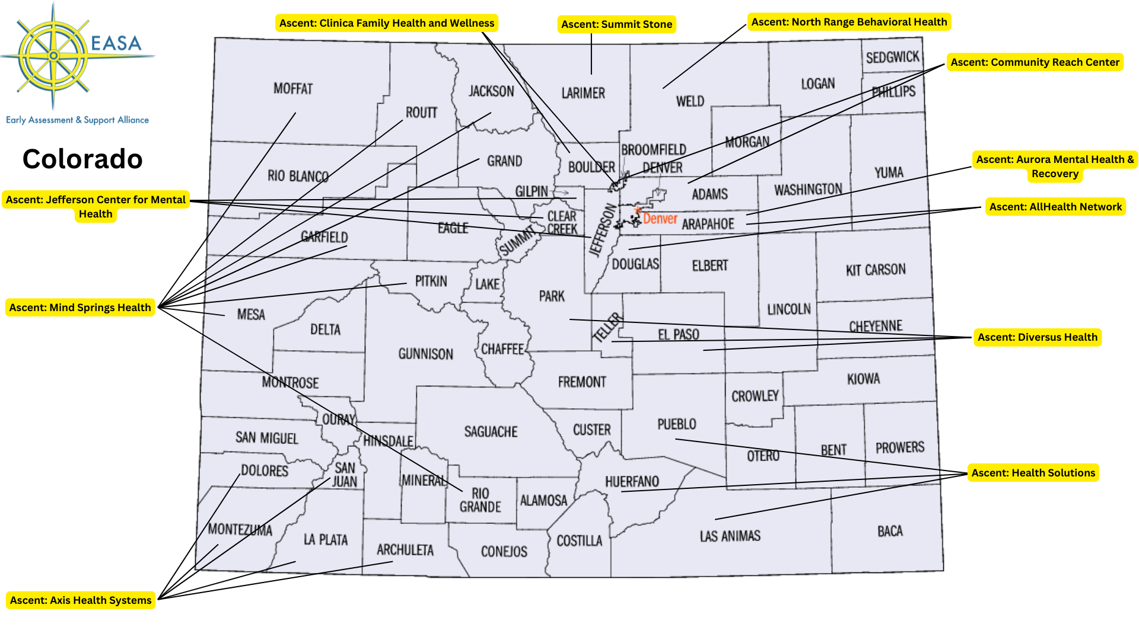
Colorado ASCENT Teams

Slide 10

Alabama NOVA Teams

Slide 11


Slide 12
Meet Your Team!

Slide 13
Team Lead/Supervisor
Staff intro and role description

Slide 14
Screener
Staff intro and role description

Slide 15
Therapist
Staff intro and role description

Slide 16
Case Manager
Staff intro and role description

Slide 17
Skills Trainer
Staff intro and role description

Slide 18
Peer Support Specialist
Staff intro and role description

Slide 19
Supported Education Specialist
Staff intro and role description

Slide 20
Supported Employment Specialist
Staff intro and role description

Slide 21
Nurse
Staff intro and role description

Slide 22
Psychiatric Care Provider
Staff intro and role description

Slide 23
Occupational Therapist
Staff intro and role description

Slide 24
What is Coordinated Specialty Care (CSC)?
Your team follows a model called “Coordinated Specialty Care for First Episode Psychosis (CSC-FEP)” that is used across the world to provide the best care possible to individuals experiencing psychosis.
“Coordinated Specialty Care is a multicomponent, evidence-based, early intervention service for individuals experiencing a first episode of psychosis (FEP) that can improve their quality of life and social and clinical outcomes.” - Substance Abuse and Mental Health Services Administration (SAMHSA, 2023)
This means that the team works closely together to collaborate and provide you and your family with supports across the different areas of your life. Your team has received special training in working with people in the early stages of experiencing psychosis. Early psychosis intervention teams follow a set of detailed guidelines based on research, best practices, and lived experience in order to provide the best possible care for participants and their family members/supports.
The EASA Center for Excellence helps to support to early psychosis intervention teams throughout Oregon and in several other states. The EASA Center for Excellence offers ongoing training, consultation and resources. Please visit www.easacommunity.org to read the current EASA Practice Guidelines & Fidelity Tool (2026) and to access additional resources for team members, family members/supports, and participants.

Slide 25
How the Team Works Together
PRESENTER NOTE: Edit this slide to accurately reflect your team’s practices
Your team is constantly working together to support not only you and your family, but to support each other during their work with you. The team is in constant communication and will work together to make sure your services are tailored to exactly what you and your family need. Team members that you are not working with may still hear updates and offer ideas to the team members that you do work with, based on their different areas of expertise. Everything discussed within the team stays confidential and will only ever be used to improve the services you receive.
Team members may do things like work together to help you achieve certain goals, coordinate appointments with each other to make scheduling easier for you, or share difficult stories with the other team members if you don’t want to tell it multiple times.

Slide 26
Common Symptoms and Experiences

Slide 27
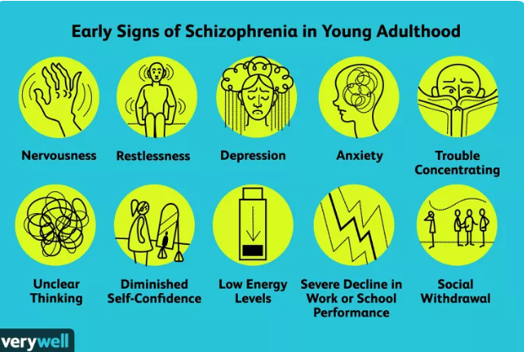
Most people do not seek help for Psychosis
In one study of 232 individuals diagnosed with a first-episode of schizophrenia spectrum disorder, they first sought treatment for:
19% - Restlessness
19% - Depression
18% - Anxiety
16% - Trouble with thinking and concentration
15% - Worrying
13% - Lack of self-confidence
12% - Lack of energy, slowness
11% - Poor work performance
10% - Social withdrawal, distrust
10% - Social withdrawal, communication difficulty
Hafner H, Maurer K, Loffler Early detection of schizophrenia: current evidence and future perspectives. World Psychiatry. 2006;5(3):130-8

Slide 28
Early Warning Signs of Psychosis
Many times, psychosis does not suddenly appear overnight. It may be that you noticed changes that started small and then worsened over time. Sometimes, these early signs can be attributed to other things, like depression and anxiety. It is important to identify your own early warning signs to be able to be proactive in self-care to possibly prevent future episodes.
Some examples of early warning signs:
Social withdrawal, difficulties in school or work, losing interest in hobbies or activities
Changes in sleep, hygiene, or eating
Confusion, difficulty with concentration, attention, or communicating
Changes in perceptions, such as seeing shadows or changes in color

Slide 29
Clinical High-Risk for Psychosis
Some individuals joining the EASA program might be experiencing psychosis-like experiences at a less intense level than others. This means that you might be having new and odd or bizarre changes to your thoughts, moods, or behaviors but are still generally going about your life as usual. These experiences may have become distressing, confusing, and have started to get in the way of life. The clinical term for these less intense experiences is “Clinical High-Risk for Psychosis” (CHRp).
You may have completed a Structured Interview for Psychosis Risk Syndromes (called the SIPS) with the EASA screener. This interview helps your team to identify the experiences you are having, the severity, and appropriate diagnosis.
Individuals experiencing CHRp are NOT destined to develop further symptoms of psychosis. Instead, these experiences show the need to get support early in order to prevent things from getting harder or having more of an effect on your life and wellbeing.

Slide 30
What is 'Psychosis'?
Psychosis refers to the experience of perceptual and processing distortions that make it difficult for a person to distinguish between what is real and what is not real
Psychosis is a bundle of symptoms, not an illness. Psychosis can be a symptom of multiple types of diagnoses and is something that many people experience in some level even if it is not severe enough for a diagnosis. For example, many people have had the experience of mis-seeing something like a street sign or trash can while driving at night. These psychotic experiences become a problem when they cause distress and get in the way of someone living their daily life.
Psychosis has a few types of symptoms: delusions and hallucinations may be the most obvious, but a person’s thinking and behavior are also greatly affected

Slide 31
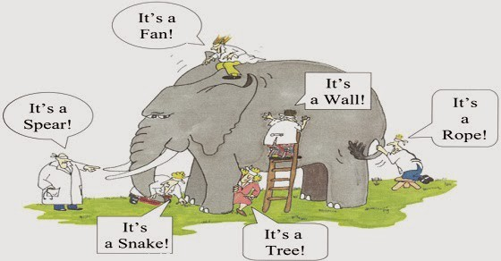
Everyone’s Experience of Psychosis is Different!
Notes:
Parable of the Elephant and the Blind Men:
A group of blind men heard that a strange animal, called an elephant, had been brought to the town, but none of them were aware of its shape and form. Out of curiosity, they said: "We must inspect and know it by touch, of which we are capable". So, they sought it out, and when they found it they groped about it. The first person, whose hand landed on the trunk, said, "This being is like a thick snake". For another one whose hand reached its ear, it seemed like a kind of fan. As for another person, whose hand was upon its leg, said, the elephant is a pillar like a tree-trunk. The blind man who placed his hand upon its side said the elephant, "is a wall". Another who felt its tail, described it as a rope. The last felt its tusk, stating the elephant is that which is hard, smooth and like a spear.
Explain that while multiple people might be experiencing psychosis, everyone’s perspective and understanding is different.

Slide 32
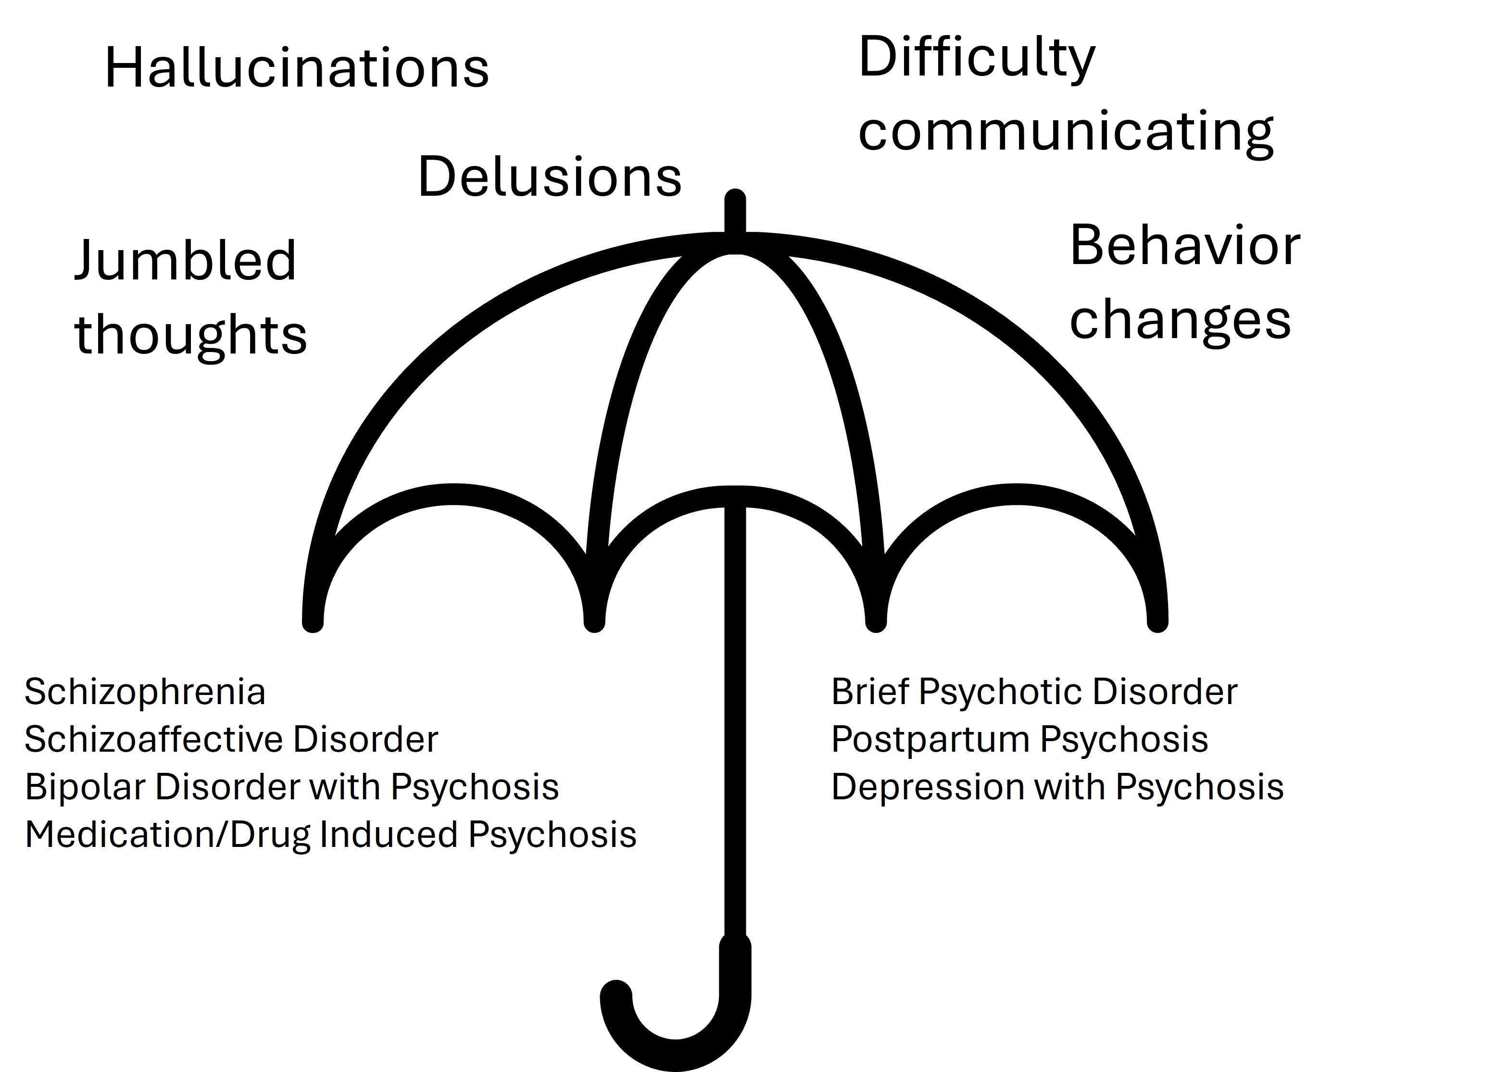
Adapted with permission from the “Hope for Carers” Family Psychosis Education Program through the University of Alberta, 2026
Notes:
Above the umbrella: all of the symptoms that “rain down” on top of those diagnoses

Slide 33
“Positive” and “Negative” Symptoms
When we talk about “positive” or “negative” symptoms, we are not stating that there are good and bad symptoms. Instead, we can think of it like a math equation.
Positive = experiences that are ADDED to a person’s usual behavior and thinking
Negative = experiences where certain abilities, emotions, and behaviors are TAKEN AWAY from a person’s usual behavior and thinking

Slide 34
Positive Symptoms
The positive symptoms of psychosis, which are the primary symptoms that identify psychosis, are Hallucinations and Delusions. These two symptoms tend to be the most visible symptoms and can sometimes cause severe disruptions to one’s life.

Slide 35
Hallucinations
Hallucinations: “a sensory experience in which a person can see, hear, smell, taste, or feel something that is not there.”¹ Hallucinations can affect any of the five senses, though most commonly will be experienced as visual or auditory
Visual: an individual may see shadows, a change or distortion of shapes and colors around them, faces or entire people, or strange things that the individual does not recognize
Auditory:
  AVH: Auditory Verbal Hallucinations are hallucinations of a voice or voices commenting on one’s daily life, or even giving commands to the individual
  Nonverbal Auditory Hallucinations:
    Buzzing
    Clicking
    Drilling
    Knocking
    Whooshing
1 Maijer K, Hayward M, Fernyhough C, Calkins ME, Debbané M, Jardri R, Kelleher I, Raballo A, Rammou A, Scott JG, Shinn AK. Hallucinations in children and adolescents: an updated review and practical recommendations for clinicians. Schizophrenia bulletin. 2019 Feb 1;45(Supplement_1):S5-23.

Slide 36

Delusions
Delusions are beliefs or ideas that one might hold as absolute truth that are not founded in reality. These delusions are often “intractable,” meaning that the person experiencing them can likely not be swayed or convinced that these beliefs are not true.
Often persecutory in nature, this might involve an individual believing they are being spied on, followed, cheated on, or poisoned
A grandiose delusion might involve the sense that one is special, a “chosen one” or that they can communicate directly with famous people, or that they can telepathically connect with others
Other types of delusions may include, but are not limited to:
Somatic – ideas that something may be wrong with one’s body
Delusions of reference – believing that there are special messages being transmitted through music/tv/etc., or that one can read others’ minds or vice versa
Notes:
Delusions are idiosyncratic beliefs or ideas about the world that are firmly maintained despite being contradicted by what is generally accepted as reality or rational argument

Slide 37
Negative Symptoms
Below are some common negative symptoms that someone may experience. This is not a complete list, and experiences can look different from person to person:
Alogia: a difficulty or inability to find words or communicate through language
Amotivation: a reduction or lack of ability to motivate oneself to start or complete tasks or work toward goals
Avolition: a reduction or lack of will or interest in activities, school or work, responsibilities, etc.
Anosognosia: inability to recognize that one’s experiences don’t align with external realities
Blunted or Inappropriate Affect: a reduction or lack of showing emotion, or showing emotions that might not be aligned with external circumstances (e.g. laughing during a sad or frightening experience)
Reduced Executive Functioning: difficulties with recognizing time, starting and completing tasks, maintaining a schedule, etc.
Impulse Control Difficulties: problems with managing impulses that may arise
Asociality: Difficulties with social cognition (thinking about what others are thinking and feeling), or withdrawing from social relationships
Notes:
Do not have to read every single item; choose a few that are the most important that you want to highlight for your specific audience

Slide 38
Negative Symptoms are not Behavioral
Negative symptoms can often get labeled as something someone is choosing to do or not do when they aren't acting the way they used to. Symptoms are related to changes in how the brain is functioning and not a choice. We encourage families and supports to remember this and offer grace to one another when things become hard.
Symptom | Is NOT
Alogia | Refusing to communicate
Amotivation | Laziness
Anosognosia | Denying a problem or refusing to accept their illness
Changed Affect | Rudeness or choosing to be inconsiderate
Adapted with permission from the “Hope for Carers” Family Psychosis Education Program through the University of Alberta, 2026
Notes:
Ensure you do not use shaming/blaming language, normalize misunderstandings and build hope and empathy

Slide 39
Causes and Things that Effect Psychosis

Slide 40
Psychosis Facts
Around 5–8% of people report experiences of psychosis during their lifetime. Psychosis can happen to anyone, regardless of their economic status, race, or other factors. Experiencing psychosis in and of itself does not mean that someone has a mental health disorder or is developing a mental health disorder.
Most people assigned male at birth are at highest risk of developing psychosis between ages 15-25, and those assigned female at birth are most likely to show signs slightly later, from 25-30.
Psychosis experiences can cause difficulties across many different life domains. It can often feel like life is “falling apart” around you. While these experiences can be very difficult and disruptive, there is still hope and plenty of time to get back on the path you want to be on.

Slide 41
Some Potential Causes of Psychosis
While there is no single identified cause of psychosis, these are a few factors that have been identified as risks for the development of psychosis:
  Genetic risk – parents, aunts/uncles, or grandparents with psychosis
  Drug use – some drugs like cannabis can increase the risk of psychosis developing or be the trigger to a psychotic episode. The risk increases the earlier substances are used, the more frequently they are used, and the higher the strength/dose of the substance
  Neurological differences – psychosis effects different parts of the brain and can impact different chemicals and structures that control thinking, mood, and many other mental and bodily functions
Many times, there is not one thing that causes psychosis. As we go through life, different risk factors may show up. Just because the risk factors are there doesn’t mean a person will develop psychosis, and sometimes people might have few risk factors and still develop psychosis symptoms.

Slide 42
Culture and Psychosis
Culture is the social behavior, traditions, values, and norms found in human societies, as well as the knowledge, beliefs, attitudes, and habits of the individuals in these groups. People's cultural identity may come from their religion, ethnic group, spirituality, or family culture.
Psychosis is deeply influenced by cultural context, which shapes the interpretation, experience, and content of symptoms like hallucinations and delusions. While Western cultures often frame these as negative, violent, or strictly medical, or related to illness, other cultures may interpret them as spiritual, divine, or relatively benign experiences. Cultural beliefs can also inform whether symptoms are stigmatized or, in some cases, seen as a sign of spiritual giftedness.

Slide 43
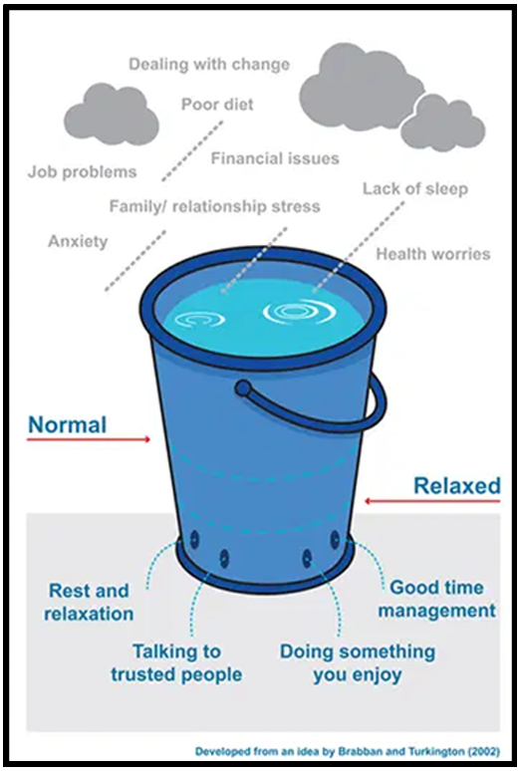
Stress Bucket Model as an Explanation for Psychosis
In the past explanations of psychosis focused solely on biological explanations such as genetics and organic differences in the brain
More recently, there's been a move toward a stress/vulnerability view of the illness in which environmental stressors (water going into the bucket), and genetic vulnerabilities (size of the bucket) interact.
What are the raindrops (stressors) that fill up your bucket?
What are the coping skills/strategies, healthy habits, and supports that help drain your bucket?

Slide 44

Types of stressors that have been linked with symptoms of psychosis
Trauma/Highly stressful life events
Trauma can be both a risk factor for the development of psychosis and a possible consequence of psychotic experiences. Experiencing trauma does not automatically mean a person will develop psychosis.
Studies estimate that 38 to 87% of individuals with schizophrenia spectrum disorders report a history of traumatic experiences.
Psychosis can sometimes lead to other traumatic experiences, such as involuntary hospitalization and overmedication or other frightening treatment experiences, interactions with law enforcement, and social alienation or internalized shame/embarrassment
Psychotic experiences themselves can also be traumatic. Some individuals report distress related to hospitalization, coercive or frightening treatment experiences, interactions with law enforcement, social alienation, stigma, or feelings of shame and confusion surrounding their symptoms.

Slide 45
Types of stressors that have been linked with symptoms of psychosis
Public Perception of Psychosis
“Stigma”: negative beliefs and perceptions about people based on a particular behavior, experience, or condition
  Stigma can come from external sources (like negative messaging about psychosis in TV and movies) or even be internalized (like believing you are somehow less-than because you experience psychosis)
Stigma about psychosis is often rooted in the lack of understanding and knowledge about the illness. There is so much misinformation and messaging about psychosis that makes it seem like people experiencing psychosis are “bad” or “scary.” Stigma can lead to things like:
  Lower self-esteem, difficulty engaging in treatment, feelings of hopelessness or shame, fears of being judged, and isolation
Stigma can be broken down! It is much harder to believe myths when someone you love shares that they are affected by the thing being stigmatized. By sharing messages of hope and recovery and busting myths that exist about psychosis, we can create a more inclusive and less judgmental community

Slide 46

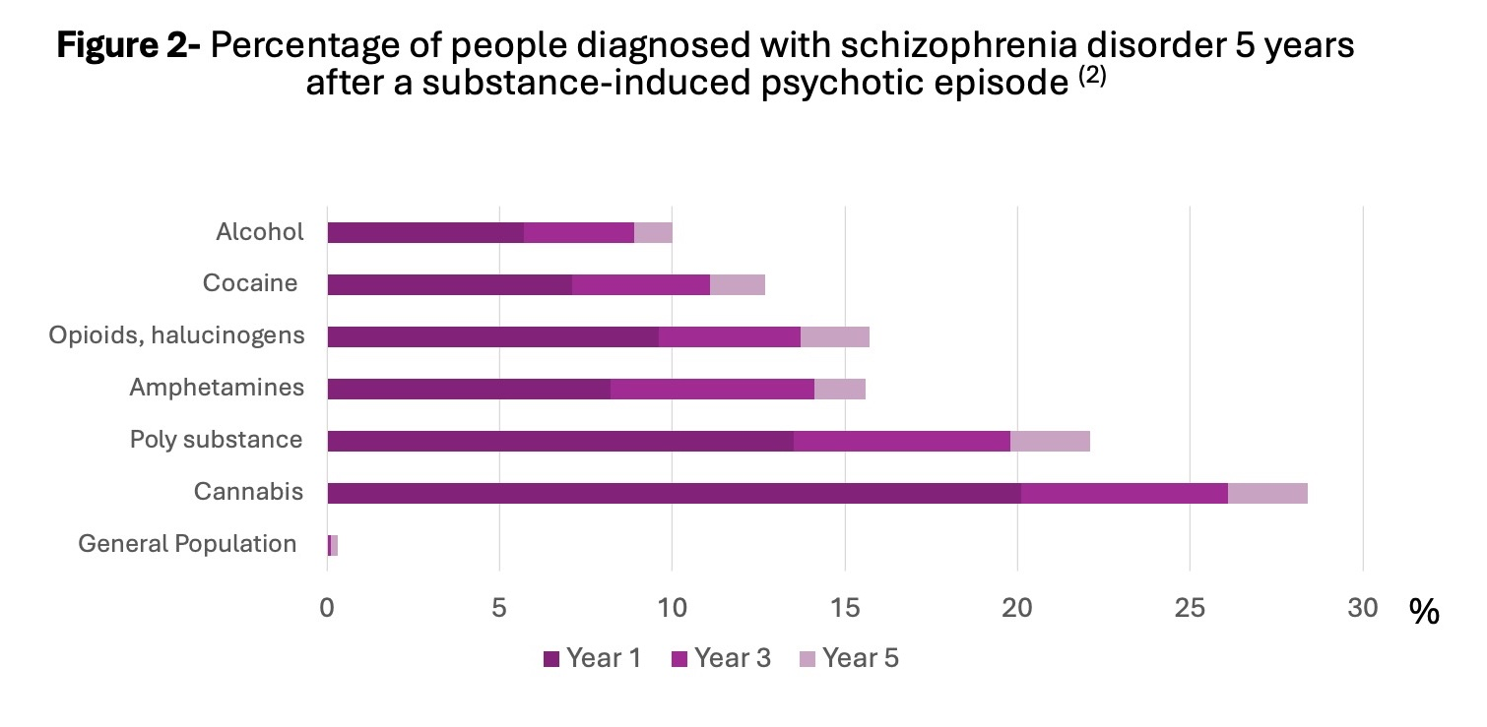
Types of stressors that have been linked with symptoms of psychosis
Substance Use/Misuse
Substance-induced psychosis is typically brief. However, substances can trigger longer-lasting psychotic disorders in individuals who are predisposed to developing them.
Drugs that can cause psychotic symptoms include: Cannabis (especially high THC), stimulants (i.e. cocaine, meth ecstasy "bath salts" and more), opioids (i.e fentanyl), hallucinogens (LSD, magic mushrooms), steroids, dissociative anesthetics (PCP/Ketamine) and alcohol.
Myran DT, Harrison LD, Pugliese M, et al. Transition to Schizophrenia Spectrum Disorder Following Emergency Department Visits Due to Substance Use With and Without Psychosis. JAMA Psychiatry. 2023;80(11):1169-1174. doi:10.1001/jamapsychiatry.2023.3582

Slide 47

Pete Davidson on Cannabis and Psychosis
https://youtube.com/shorts/QATThGamIwk?si=yIqK15M8inNlIOG9

Slide 48

Recent research linking cannabis use and psychosis
Recent Canadian studies show 11-fold increase in the risk of developing psychosis for young users (Scientific American, Feb 3, 2025).
The higher the THC level and the earlier a person begins using cannabis, the higher the risk.
47% of young people experiencing cannabis-induced psychosis converted to schizophrenia within 3 to 4 years (Starzer et al, 2017).
In individuals with schizophrenia, using marijuana leads to a worsening of psychotic symptoms like paranoia and hallucinations. Regular cannabis use may worsen outcomes for those with schizophrenia or other psychotic disorders.

Slide 49

Cannabis and Psychosis Video
https://youtu.be/VD2AvIXVgOw?si=mBn0z9hxpkpFQLfm

Slide 50
Types of stressors that have been linked with psychotic symptoms
Sleeplessness or Low-Quality Sleep
Many people experience difficulties with sleep. Good quality sleep is especially important for individuals experiencing psychosis. Troubles with sleep may:
Be linked to the start of psychosis or with relapses
Worsen psychosis
Affect other parts of your mental health (e.g., mood, concentration, memory and thinking).
Be linked to physical health problems (e.g., other medical diagnoses).
Adapted from: Sleep Health Foundation. (2024, January 12). Schizophrenia and sleep. https://www.sleephealthfoundation.org.au/sleep-topics/schizophrenia-and-sleep

Slide 51
Common Diagnoses

Slide 52
An Important Note:
This presentation is not intended to diagnose – your diagnosis will be considered with the team and may be fluid over time. It can take time, relationship building, and further assessment to determine a specific diagnosis and diagnosis(es) can change over time. The most important thing is addressing symptoms and problems that YOU identify as most important and want to focus on.
Diagnoses can sometimes help to guide treatment and identify tools that may be helpful to you in your recovery. Your team will partner with you wherever you are at and however you choose that to look, regardless of the diagnosis.
Notes:
Encourage everyone to write down questions they have about their specific circumstance, and explain you can review these in individual/family sessions. If they have general questions, this is a great time to discuss

Slide 53

Team Approach to Diagnosis....
Diagnosis is just one way to describe a set of symptoms. It guides clinicians in determining best treatment approaches. DSM-5 is the most used in the US for mental health diagnosis.
We meet where you are in terms of your own beliefs about the idea of diagnosis.
  Your team is primarily interested in addressing symptoms that are causing you distress and helping you work on goals that are important to you and align with your values and needs.

Slide 54
Team Approach to Diagnosis....
Keep in mind:
  Diagnosis is a snapshot
    It can be difficult to pinpoint a specific diagnosis initially. Diagnostic labels frequently change early on.
  Individuals' experiences don't always fit into a diagnostic box
  Mental health terms are often used by people in ways that don’t align with their definition. The way these words are used as slang are often stigmatizing, misleading, or inaccurate (like saying someone is “schizo” when they are acting erratically)
How can diagnosis be useful?
  It can help with accommodations at school and/or work
  It creates a shared language or understanding
  Helps to guide how the team can offer the most helpful support – often called “treatment planning”

Slide 55
Team Approach to Diagnosis....
Your team works toward reaching a diagnosis using transdiagnostic approaches
  https://www.nami.org/blog/the-transdiagnostic-dimensional-approach-another-way-of-understanding-mental-illness/
  “Transdiagnostic approaches” think about mental illness “as an extreme and stressful version of common experiences, rather than as categories of distinct experiences.” This means that we try to avoid putting your experience into boxes and instead explore the different ways that your experiences show up.
How can diagnosis be useful?
  It can help with accommodations at school and/or work
  It creates a shared language or understanding
  Helps to guide how the team can offer the most helpful support – often called “treatment planning”

Slide 56
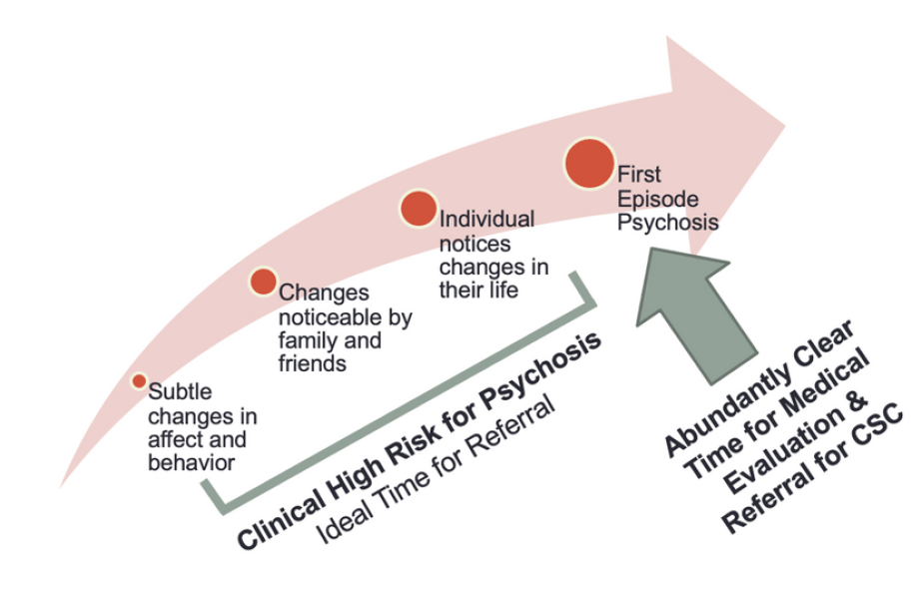
Clinical High Risk for Psychosis
Also known as Psychosis Risk Syndrome or Attenuated Psychosis Syndrome
There are typically signs that symptoms of psychosis are developing before a full episode of psychosis occurs.
Clinical High Risk for Psychosis (CHRp) describes a set of experiences that may indicate someone is at increased risk for developing psychosis. These experiences are often new, confusing, or out of character, and can feel overwhelming, but they are also common, treatable, and does not a indicate a specific diagnosis.
  (https://www.lanecountyeasa.org/what-is-chrp)
Clinical high-risk symptoms involve mild or infrequent hallucinations, delusions, or disorganized speech that do not meet full psychotic disorder criteria but cause significant distress.
The individual typically retains insight into the changes that are occurring. Insight: a person’s awareness, or lack thereof, of mental health symptoms

Slide 57
DSM-5: Schizophrenia
Two (or more) of the following, each present for a significant portion of time during a 1-month period (or less if successfully treated). At least one of these must be (1), (2), or (3).
Delusions
Hallucinations
Disorganized speech (e.g. frequent derailment or incoherence)
Grossly disorganized or catatonic behavior
Negative symptoms (i.e., diminished emotional expression or avolition).
Notes:
Specify first episode currently in acute episode

Slide 58
DSM-5: Schizoaffective Disorder
An uninterrupted period of illness during which there is a major mood episode (major depressive or manic episode) while meeting criteria for schizophrenia
Delusion or hallucinations present for 2 or more weeks in the absence of a major mood episode
The mood episode/mood symptoms are present for the majority of the total duration of the active and residual portions of the illness
Similar to other exclusions, the mood symptoms are not attributable to a substance (abusable substance, medication)

Slide 59
Schizophrenia and Schizophrenia-Spectrum Disorders, in other words…
Schizophrenia is the most commonly known diagnosis that people attribute to psychosis. However, there are multiple diagnoses that fall under what is called “schizophrenia spectrum disorders.” Many of the differences between these diagnoses are about the length of symptoms, presence or lack of certain psychotic symptoms, and presence of mood instability (like depression or mania).
Other common diagnoses you might hear are:
  Brief Psychotic Disorder – a short-term (under 1 mo.) single episode of psychosis
  Schizophreniform – a short-term (under 6 mo.) experience of psychosis
  Delusional Disorder – psychosis that does not present with hallucinations, instead presents with delusions as the primary experience

Slide 60
DSM-5: Major Depressive Disorder
Five (or more) of the following symptoms present for the same 2-week period representing a change from previous functioning; at least one of the symptoms is either (1) depressed mood or (2) loss of interest or pleasure.
Depressed mood most of the day, nearly every day (sadness, emptiness, hopelessness)
Markedly diminished interest in things that previously gave one pleasure
Significant weight loss when not trying to lose weight or weight gain in the absence of desire to, or loss of appetite
Insomnia or hypersomnia nearly every day
Psychomotor agitation or slowing nearly every day that is observable to others
Fatigue or loss of energy nearly every day
Feelings of worthlessness or excessive guilt plaguing someone nearly every day
Diminished ability to think or concentrate, or marked indecisiveness
Recurrent thoughts of death, recurrent suicidal ideation without a plan or suicidal planning, or an attempt to end one’s life
Notes:
Don’t spend time here – focus on the “In Other Words…” slides

Slide 61
Depression, in other words…
Depression is not just being sad or having a hard time. When someone is experiencing depression, it means that they are struggling to function or are moving through the world as if there is a heavy weight holding them down.
People living with depression often experience:
Profound hopelessness, sadness, or numbness. This often is joined by feelings of worthlessness or guilt
Extreme difficulties with finding a reason or the will to move through life
A severe and sudden loss of interest in things they once loved
Deep fatigue, regardless of the amount of sleep they get
Changes in appetite, potentially leading to weight gain or loss

Slide 62
DSM-5: Manic Episode
In that episode of mood disturbance and increased energy or activity, three or more of the following (four if the mood is only irritable) must be present and represent a noticeable change from baseline:
Inflated self-esteem or grandiosity
Decreased need for sleep
More talkative than usual or pressure to keep talking
Flight of ideas or subjective experience of racing thoughts
Distractibility (attention to easily drawn to unimportant or extraneous details)
Increased in goal-directed activities or psychomotor agitation
Excessive involvement in activities that have a high potential for painful consequences (unrestrained buying, sexual activity that one may regret, posting things online that one would regret)

Slide 63

Bipolar Disorder, in other words…
Bipolar Disorder is diagnosed if someone has experienced both depression and a manic episode.
Mania is not just hyperactivity – it is a period of time where someone often loses the ability to sleep, feels “on top of the world” or feels invincible. This may look like rapid speech, increased energy, grandiosity, and an increase in risky behaviors.

Slide 64
Recovery and Personal Understanding of Psychosis

Slide 65

Lived Experience of Psychosis Video
https://youtu.be/lUT2SUuw3z4?si=WzYu6z8f1MZzkvYL

Slide 66
Recovery from Psychosis
Recovery is not only possible, it is expected! One study found that there was a 38% recovery and 58% remission rate for individuals with First Episode Psychosis:
  Recovery in this study is defined as improved functioning and few or no symptoms for at least 1-2 years or more.
  Remission in this study is defined as a reduction in symptom severity with sustained periods (at least 6 months) of low or no symptoms
Frequent factors in improved remission/recovery rates:
  Active engagement in early treatment – the earlier the better!
    This isn’t just attending sessions – it’s about the work you do for yourself in daily life! This could look like actively participating in therapy and other services, such as occupational therapy or working with a peer support specialist, and applying those skills out of session, working with providers to find the right medicine for you, or working with the team to identify and work toward your goals like successfully returning to work and school
  Supportive family/support network involvement
  A focus on physical health and activity
Remission and recovery from first-episode psychosis in adults: systematic review and meta-analysis of long-term outcome studies
Three-year outcomes and predictors for full recovery in patients with early-stage psychosis

Slide 67
What does "Relapse" Mean ?
A relapse means that your experiences of psychosis are getting in the way of what you want in life again. Different people experience relapses in different ways. Some never experience a relapse. Some people only have a few relapses. Others have regular cycles of relapse.
A relapse does not mean you have done anything wrong, or that there is anything wrong with you. It is a typical experience, which is why there is process called relapse planning that your team will support you in developing and implementing. This process will be refined throughout your time in the program as you discover what works for you in preventing or navigating a relapse of symptoms.

Slide 68
Recovery Is Possible!
Authors of a study from 2022 examining recovery after first-episode psychosis found that, psychotic disorders, such as schizophrenia, “continue to be viewed as chronic, although it has been firmly established that many will fully recover.” In the study they note that “most of our participants were in psychotic symptom remission, (and) psychosis appears well managed for most.”
Three-year outcomes and predictors for full recovery in patients with early-stage psychosis

Slide 69
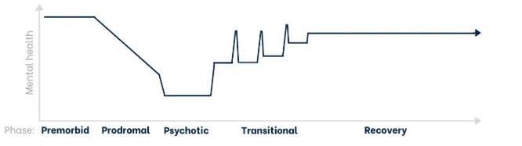
Impact of Early Intervention on Recovery Outcomes
Notes:
PRESENTER NOTE: Be sure to highlight that the level of recovery is different for everyone, so the “recovery” line may even meet the same level of “premorbid”

Slide 70
Psychosis and Self-Discovery
Experiences of mental illness or psychosis can be an opportunity for self-exploration and finding out new discoveries of oneself
Sometimes we learn the most about ourselves when we are going through difficult times
Learn what values and areas of life are most important to us
Identifying and building your supports
Finding out what helps you through tough times
Exploring what is helpful and not helpful when you are experiencing symptoms

Slide 71
Psychosis and Identity
Psychosis or a mental health diagnosis is not an identity, it is a part of someone's experience in being human
It can feel like the experience of psychosis is taking over your life and becoming who you are. However, your experience with mental health is only one part of what makes you, you. While it may affect how you move through the world, it does not have to be an entirely negative effect or take over your identity.
Whatever other things you identify as are still just as important as they used to be. You are still an artist, a sibling, a parent, an athlete, a community member, a friend, etc. There may be things that change due to your experiences with psychosis, however, that is not necessarily negative. It is typical for people to change and explore different parts of their identity as they move through life, and that is no different for people who have experienced or who are experiencing psychosis.

Slide 72
Your Psychosis “Story”
Psychosis has a unique meaning for everyone who is impacted by it. That means that, even people in the same family who are going through the same situations, have a different experience and story of what is happening.
Many times, people who experience psychosis, as well as their loved ones, might feel like their story is a hopeless one, or that this part of their story means that life as they knew it is over. While life might look different as you move through your recovery journey, that doesn’t mean you can no longer achieve goals or be who you want to be.
As you go along in your journey, it can be helpful to think about the story you are telling yourself or others about your psychosis. What meaning do you find in the experience? How do you understand and explain it?

Slide 73

Lady Gaga’s Psychosis Story
https://youtu.be/PFuCSwbJ9D8?si=CBIK3hGSu3eVetgj
Notes:
Optional: longer video, cut if needed

Slide 74
Discussion
What is one part of what you want your story to look like in the future?

Slide 75
Typical Developmental Stages and Psychosis
Notes:
Presenter notes: cater to your audience, focus on what’s relevant to your group

Slide 76
Symptoms vs Typical Development
Psychosis often coincides with, or is triggered by, the process of "synaptic pruning" that accelerates during adolescence (around age 11-12) to optimize neural efficiency. The peak age for first-episode psychosis is the late teens to mid-20s for males and late teens to late-20s for females.
This timeframe aligns with major life milestones, including finishing school, starting careers, and establishing independent relationships.
With the adolescent years and early adulthood being a time of rapid change and identity exploration, it can sometimes be difficult to distinguish some symptoms and behaviors that are typical.
Things to look for:
  Out of character behavioral/personality changes
  Bizarre new beliefs or interests
  Suddenly losing interest in things they once cared about

Slide 77
Typical Developmental Changes During
Adolescence (puberty through age 18)
Main Developmental task: Begin to establish personal identity
Period of dramatic physical change and sexual maturation
Increased ability to think about abstract concepts and see different perspectives (i.e. love, justice, freedom)
Right and wrong framework of thought (black and white thinkers)
Peers become more important (strive for a sense of belonging)
Relationships have a reciprocal quality ("You scratch my back, and I'll scratch yours.").
Intensified emotions (hormone-related)
Exploration of new roles and responsibilities (dating, driving, part-time job...)
Sources: MIT: Young Adult Development Project
https://hr.mit.edu/static/worklife/youngadult/changes_ya.html
https://courses.lumenlearning.com/wm-lifespandevelopment/chapter/periods-of-human-development/

Slide 78
Typical Developmental Changes During
Emerging Adulthood (age 18 to 22/25)
Main developmental task: Develop self-sufficiency
Rewards against future consequences which starts to put the brakes
In-between period when individuals are still figuring out their identity and don't quite feel like adults yet ("Who Am I and How Do I Fit In?")
More complex thinking – values, perspectives, morals evolve
Appreciation for diverse views develops- can recognize and value many points of view at one time
Mutuality in relationships- the Golden Rule with deepened awareness of differing points of view shapes relationships and interactions
Emotional regulation- can weigh immediate results of risk-taking and thrill seeking
Able to make thoughtful decisions about their own future (relationships, careers, education) and evaluate the impact of personal choices on others - 'the age of possibilities'
Sources: Bredehoft, Psychology Today. April 2021, MIT: Young Adult Development Project
https://hr.mit.edu/static/worklife/youngadult/changes_ya.html, https://courses.lumenlearning.com/wm-lifespandevelopment/chapter/periods-of-human-development/

Slide 79
Typical Developmental Changes During
Young Adulthood: (mid 20s and older)
Main developmental task: Earn the status of a full adult in the eyes of society
New levels of abstract analysis – self-awareness in organizing abstract ideas
More complex problem-solving abilities – sophistication in thinking through moral dilemmas and in articulating decisions based on complex thoughts
Enhanced leadership abilities
Greater capacity for self-evaluation
Internal commitments in work and relationships- more self-awareness and influence over one's own decisions
Sources: MIT: Young Adult Development Project
https://hr.mit.edu/static/worklife/youngadult/changes_ya.html, https://courses.lumenlearning.com/wm-lifespandevelopment/chapter/periods-of-human-development/

Slide 80
Team idea
Everyone contribute a picture of themselves from youth/young adulthood to highlight that we were all youth/young adults at one time and that we got through it! :)
If people are willing, share a fun story about their teen/YA years or identify a mentor or support person/family member who was or is important to them as a youth/young adult

Slide 81
Discussion
What do you see as the biggest changes happening in your/your loved one’s development right now?

Slide 82
EASA Principles

Slide 83
Cultural Humility and Trauma-Informed Care
Individuals receiving services are experts in their own lives—what is seen as distressing to one person may not be to someone else
Trauma-informed, culturally responsive care includes approaches and interventions that affirm and honor the values, beliefs, traditions, healing practices and needs of individuals and family members and supports
As much as possible team members will not ask you to repeatedly share difficult or traumatic experiences, and will be responsive to your needs and trauma history

Slide 84

Person-Centered Care
We are the experts on our own experiences
We don't have to agree about a decision, but rather work together to make the best possible outcome and provide a safety net
Dignity of risk and importance of "failure“
  We learn through failure, and right now is the best time to try new things because you have an incredibly strong safety net through your team
The participant is “driving the bus” and picking the destination; the team, family, and supports can act as navigation help, pit crew, etc.

Slide 85
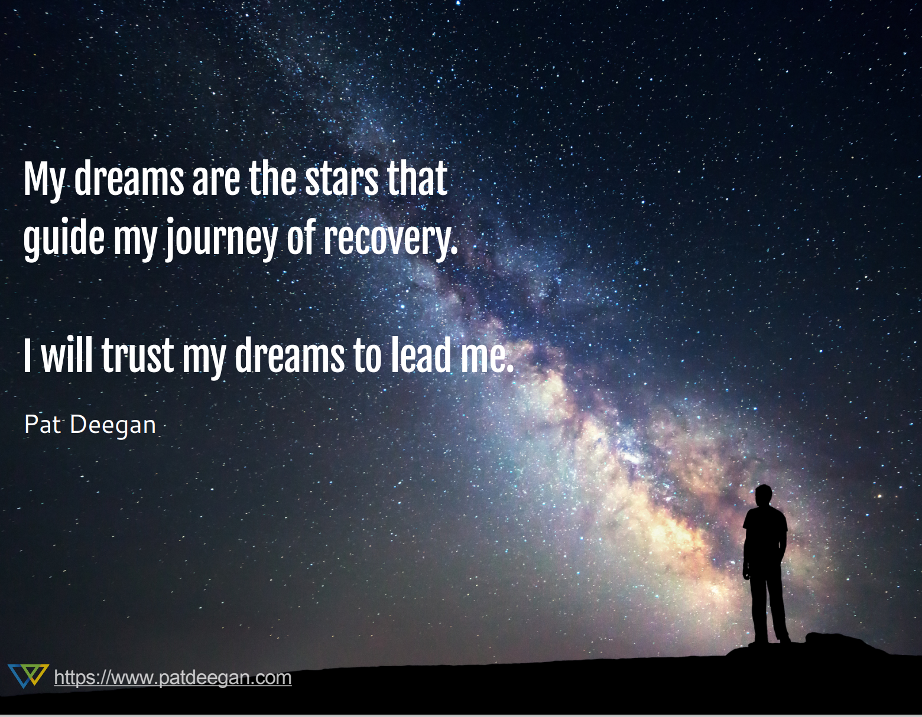

Slide 86
Shared Decision-Making
In shared decision-making, participants and providers communicate with each other and come up with a plan together based on:
what is important to the person
mutual understanding of all options
mutual understanding of the pros and cons of each of those options
Shared decision-making is a way to make an informed choice about healthcare and services that respects both the person's priorities and the provider's experience.
A note: while families may be involved in the shared decision-making process, the goal is to prioritize the participant’s choices and provide supports and a safety net in a way that supports growth and development

Slide 87
Shared Decision-Making Lived Experiences
EASA Graduate Quote:
"One, be honest with your treatment team. If something is not working for you, or you need something new, let them know. You cannot get the help you need if you do not keep your team in the loop. Two, figure out what works best for you. I liked having multiple team members in one room to discuss future decisions; however, you may not like that and rather speak one-on-one and that's okay. If you feel like your voice would be better heard through just one team member, you should go along with that feeling." -NC
"In an EASA treatment team, you will be working towards your overall well-being, and you should try to collaborate and consider other members' perspectives as well as your own. Each person on your team plays a different role which means that people may have differing opinions on what is right for you. Compromise may be necessary including with family members. So just remember that it is all for your future." -S

Slide 88
What can EASA do for you?
PRESENTER REMINDER: Be sure to change “EASA” throughout presentation to reflect your program’s name
Notes:
Edit any slides to reflect the services offered on your team

Slide 89
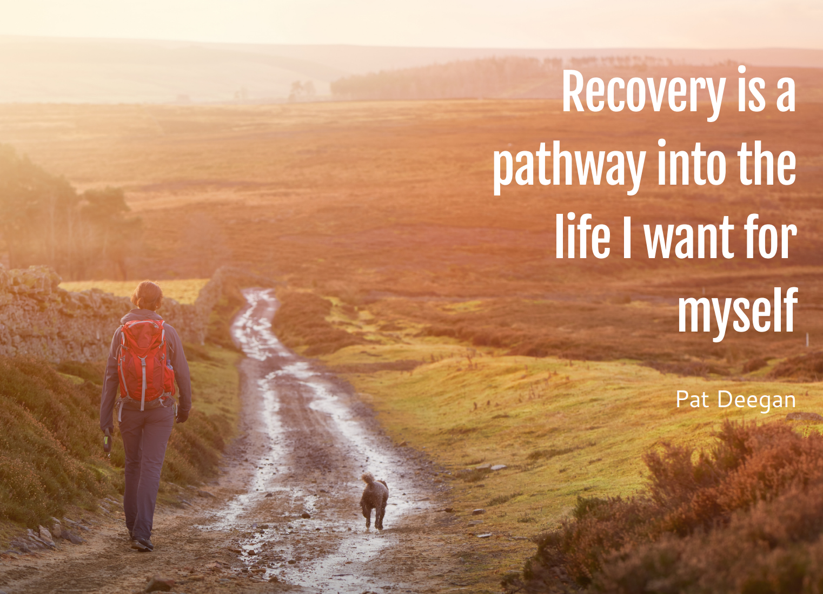

Slide 90
Overview of Treatment
Outreach and engagement
Individualized assessment, diagnosis, and treatment planning
Individual and group counseling
Single and/or multi-family groups
Education and support for individuals/families/primary support systems
Crisis planning and relapse prevention planning
Information about rights and benefits
Assistance with independent living skills for daily living and working
Information about resources and assistance with connecting to those resources
Support in school and work settings through Supported Employment and Education services
Opportunities for mentoring and meeting others with similar experiences
Medication support and education
Nursing/Physical health services that focus on wellness
…And more! Talk with your team if you have areas you would like to work on that aren’t listed here!

Slide 91
Tools
Throughout your time in the program your team will help you build tools to maintain recovery. The following are some specific tools you will create with your team:
Wellness plan – what keeps you healthy
Crisis plan – what keeps you safe
Relapse prevention plan – what keeps you stable
Strengths assessment/narrative/values card sort – what you’re interested in and enjoy doing
Comprehensive risk assessment – what your “pink flags” or warning signs are
And more!
Notes:
Don’t feel like you have to go into detail about what each of these forms are, but give a general overview of what they are and how they can help recovery

Slide 92
Medications

Slide 93

The Human Brain
There are around 128 billion neurons in the human brain with approximately 500 trillion neuron-to-neuron connections.
This intricate network makes mental life possible and requires nurturing, a balance of safety and security with stimulation and an optimal amount of stress.
In order to grow, we need to be challenged enough to develop skills and make new neural pathways, but not so stressed that we grow overwhelmed and defeated.

Slide 94
Brain Development
We know that life cannot and should not be reduced to thinking only about a group of chemicals that our brain uses.
A rich life involves not only the ideas and emotions our brain is responsible for, but also things like:
healthy relationships with others,
physical activity and feeling like we can make things happen in the world,
being influenced in positive ways by peers, siblings, caregivers, mentors, teachers, and for some spiritual guides.
Finally, we know our thoughts, feelings, and behaviors are influenced by having access to tools like computers or good relationships where we feel valued.

Slide 95
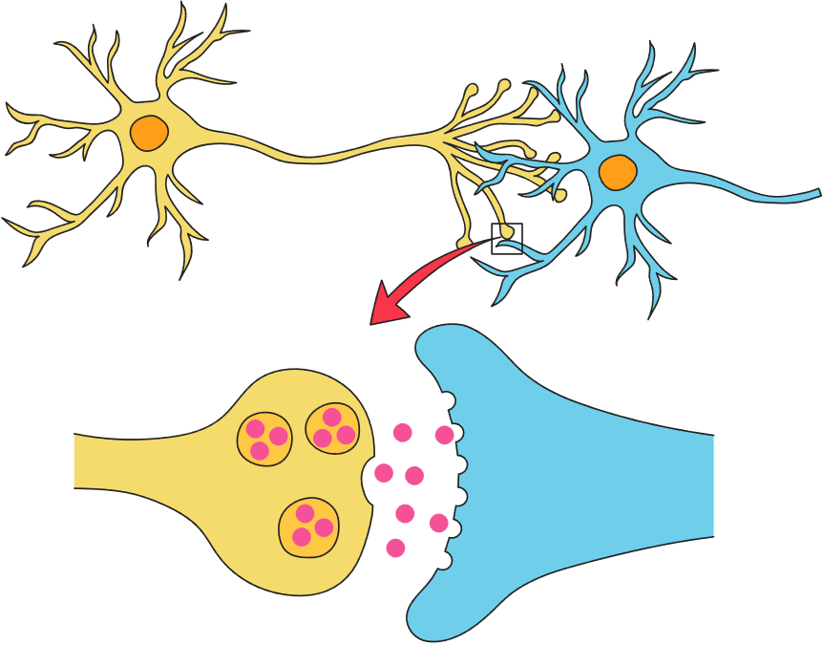
Brain Communication
Brain cells (called neurons) communicate with each other, sending and receiving molecules that are called neurotransmitters. You’ve probably heard of the some of the main neurotransmitters (pink circles):
Dopamine
Histamine
Epinephrine
Norepinephrine
Serotonin
Gamma Aminobutyric Acid (GABA)
Glutamate
Notes:
Don’t feel like you have to go into detail about what each of these forms are, but give a general overview of what they are and how they can help recovery

Slide 96
Brain Signaling
Sometimes the brain signal system can become overwhelmed. One region of the brain or human experiences may become more dominant.
  For example, in anxiety disorders, signals of danger or what one needs to watch out for might become overwhelming.
Psychiatric medications are meant to strengthen the connections that some areas of the brain make with one another and sometimes reduce the signals that one region of the brain is sending to another portion.
  For example, a good treatment for anxiety might reduce activity in regions responsible for panic, or strengthen areas of the brain that get activated when we reassure ourselves that everything is going to work out
Notes:
Don’t feel like you have to go into detail about what each of these forms are, but give a general overview of what they are and how they can help recovery

Slide 97
Dopamine Blocking Medicine
Medicines that block dopamine in the brain, particularly in a region that is responsible for sending signals of “IMPORTANCE” or “DANGER” can help us filter out noise and not be so distracted by external details (sights, sounds) or internal experiences (hearing voices, having really intense ideas) that may be overwhelming.
Medical providers on your team may encourage using these medicines (often referred to as “anti-psychotics”) at least for a short time to help rebuild a sense of safety to help people feel more at ease and able to engage with the world, do things they enjoy, or learn with less internal or external distraction.

Slide 98
Serotonin or Norepinephrine Enhancing Medication
Medicines that enhance transmission or signaling of serotonin or norepinephrine can be helpful in treating depression and anxiety.
  These are sometimes called “anti-depressants.” They do NOT fix “chemical imbalances.”
  Instead, when they are effective, they actually help regions of the brain grow so that we feel less overwhelmed with anxiety or having thoughts that might bring us down. Medical providers on your team may encourage using these medicines.
Notes:
Don’t feel like you have to go into detail about what each of these forms are, but give a general overview of what they are and how they can help recovery

Slide 99
Medical Providers
Like all team members, the nurse and psychiatric care provider(s) in your program are interested in you and in your values, needs, and goals. They are dedicated to meeting with you regardless of whether you wish to take psychiatric medications.
  They will respect your views, listen to your goals, and be honest with you about potential options. This might include a conversation about the pros and cons of certain psychiatric medications AND will include conversation about sleeping, eating, physical activity, and other substances that might make things worse or better.
Your medical team will keep an open mind and share with you their experience from studies, from working with others, and trust your lived-experience expertise! No one on your team will ever force medication but instead will help you think through all of the options and figure out what is best for you.

Slide 100
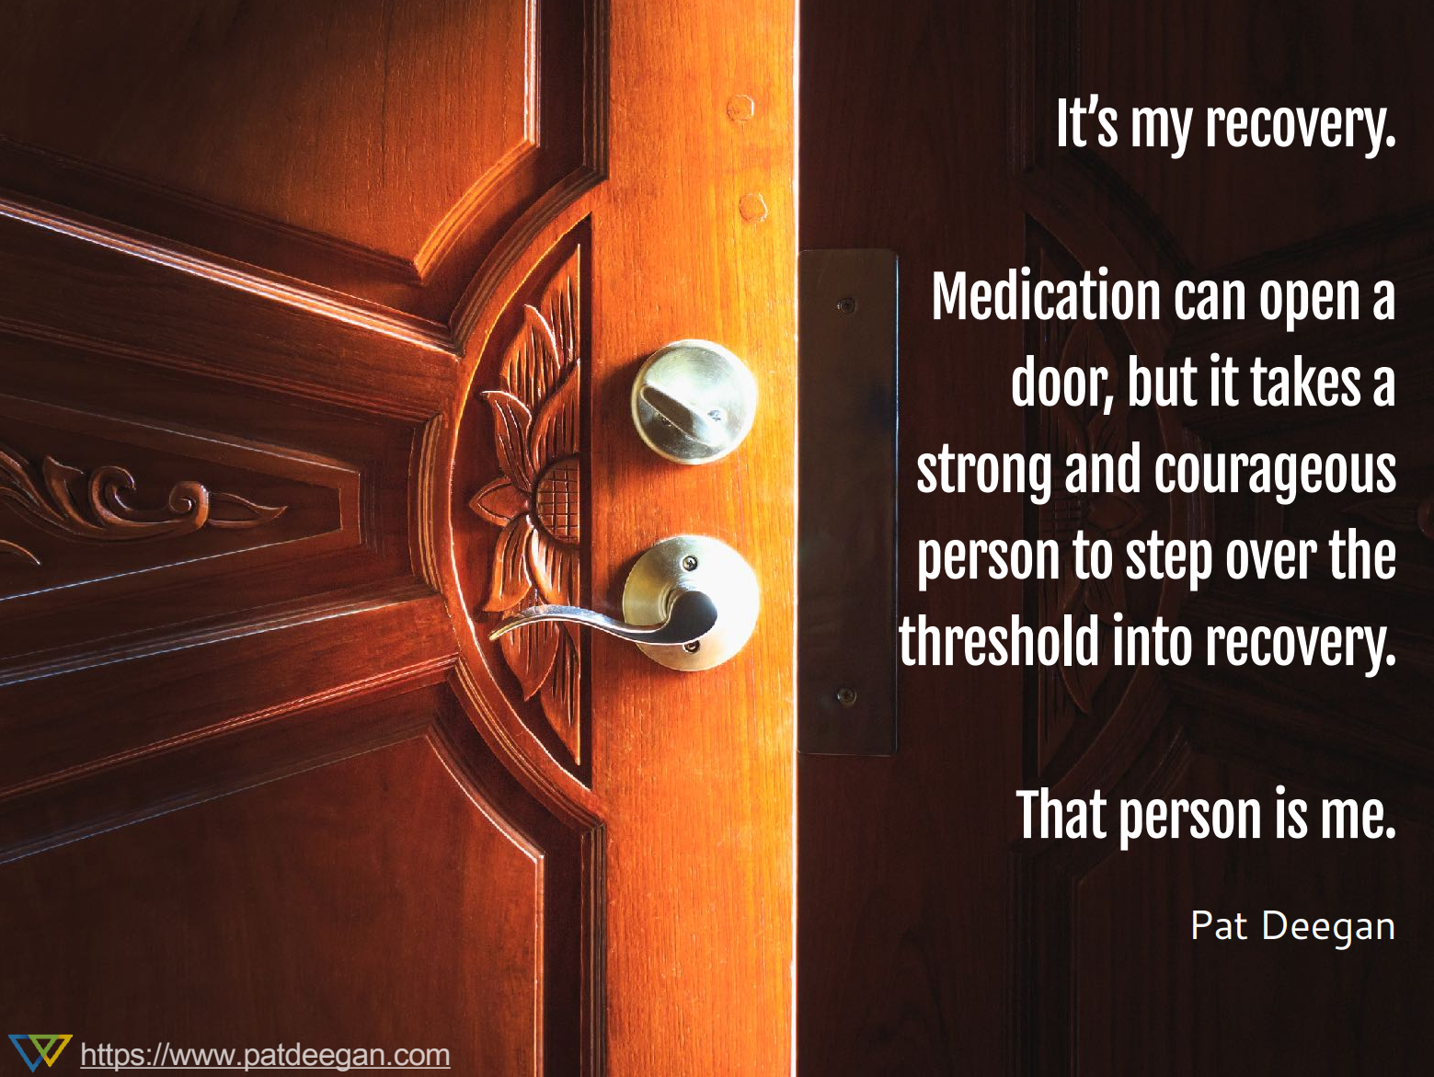

Slide 101
Crisis Management
Notes:
Keep this section positive and as light as possible. Highlight that crises are not personal failures, and are more likely to be avoided with high engagement in treatment and collaboration with the team

Slide 102
How does my team approach crisis situations?
When we talk about “crises,” we mean times where someone might be at risk of harming themselves or someone else, or if someone is experiencing symptoms to the extent that they cannot care for themselves or need a higher level of care. The team will work collaboratively with you during times of crisis or intense moments of distress.
Early psychosis intervention teams work with participants and their supports to avoid hospitalization whenever possible – we want to see you doing well at home/in your community! However, sometimes it may be necessary for someone to be hospitalized so that they can be safe and receive necessary medical care. If you are concerned about being hospitalized, especially if you have had negative experiences with hospitalization in the past, talk to your team about those concerns and ask questions or share your concerns. Your team will help you plan and do as much as possible to prevent situations that might lead to hospitalization. If you do need to be hospitalized someone from your team will accompany you to the hospital (with your permission and whenever possible) and will keep in touch with the hospital staff to coordinate treatment while you are there.

Slide 103
Crisis prevention planning
From the very beginning your team will work with you and your supports to help plan and prevent crises situations as much as possible. It is important to work with your team to create a crisis plan just in case issues (such as an increase in symptoms or family conflict) arise that may increase stress for you or your family or cause other difficulties.
You, your family members/supports, and your team will work together to create a crisis plan and discuss specific situations where you or a family member or support person might need to call the 24-hour crisis line. Your team will help you practice what to say when you call, and what information will be helpful to give to the crisis line staff.

Slide 104
Calling Crisis Services
PRESENTING TEAM MUST EDIT FOR SERVICE AREA
Explain what the process is for calling your local mobile crisis or crisis unit, and what people can expect. Some questions or considerations of what to include might be:
  Is law enforcement present/involved, if so, how? (i.e., if transport is provided by police and do they handcuff before transport)
  What information will be asked, and who will be asked to provide information?
  What is the working relationship between your team and the crisis team/unit? How can the team advocate for participants in these moments?
  How long do crisis unit stays generally last?
Ensure you include any other important information about your local crisis service continuum and those interactions.
PRESENTERS: INCLUDE CRISIS NUMBERS AND RESOURCES

Slide 105
Hospitalizations
Some, but not all, people who experience psychosis have experiences with hospitalization. If you have these experiences, you are not alone. For many individuals, being in the hospital can be a positive experience and lead to more stability and other positive changes.
You, your family, and your team might decide together that the best way for you to stay safe and heal is to go to the hospital. If it's a true shared decision, hospitalization can be a positive experience, especially when the decision is made
  based on what's important to you;
  with you having the information you need to participate in the decision; and,
  after you have weighed all the pros and cons,
If you end up in the hospital against your will, you might have fewer choices. However, you still have the right to be heard, to be told the truth, and to be treated respectfully and with genuine concern. If you are at the hospital, no matter how you got there, you should still be able to use shared decision-making approaches with your providers both in and outside of the hospital.

Slide 106
Working with Your Team During Hospitalization
PRESENTERS: Explain your team’s process in supporting participants and families during the hospitalization process.
See EASA Practice Guidelines & Fidelity Assessment Tool (2026) Section 4.12 Maintaining Engagement during Psychiatric Hospitalizations for specific guidance

Slide 107
Lived Experience Panel
PRESENTERS:
Have current participants, graduates, and current/past family members participate in a Q & A panel about their experience in the program and/or experience in MFG/Single-family
Work with individuals ahead of time to prepare them for what they want to share/do not want to share
Provide transportation (bus passes, etc.) and compensate them for their time and expertise.

Slide 108
Understanding Privacy

Slide 109
HIPAA
The Health Insurance Portability and Accountability Act (HIPAA) is a federal law for keeping health information private. HIPAA prevents healthcare providers, most health insurance plans, and other healthcare agencies from disclosing your personal health information without your written permission. Health information protected by HIPPA is:
Anything in your medical record
Conversations your providers have about your care or treatment (for example, conversations your doctor may have with his nurse about your care)
Information about you in your health insurer's computer system
Your medical billing information
Most other health information about you held by anyone involved in the healthcare system

Slide 110
Exceptions:
PRESENTERS: Ensure this aligns with the laws in your area
If you say you want to hurt yourself or someone else, your provider is required by law to share your information in order to help you stay safe.
If you tell us about the abuse of a child, elder, or person who receives mental health or developmental disabilities services. These types of people are under "mandatory reporting" laws, where abuse against them must be reported to the Department of Human Services.
If your information is important to a court case or legal matter, there is a legal document that could request your information.
Notes:
Ensure this reflects the laws in your state

Slide 111
Release of Information (ROI)
If you give your permission, your information will be shared as you have asked. HIPAA only prevents unauthorized sharing of your health information. You can give your permission in writing to share some or all of your health information with someone else using a Release Form. You can also change the level of consent (meaning that you want more or less information to be shared) or revoke it at any time. Talk to your team about what you want to be shared, or what you don’t, and they will respect your decision or explain when they are required to share certain things.
For Caregivers: Sometimes, when a loved-one needs hospitalization, they are overwhelmed and may refuse to sign an ROI. This can be distressing for parents, who are then out of the loop. If this happens, remember that, even if the treatment team providing care can't share information with YOU, YOU can share information with THEM. This can be very helpful in filling in the blanks for emergency care providers.
Suggestion: Create a one-page medical history and keep it on-hand for emergencies. Summarize course of illness, medications etc.

Slide 112
Family Engagement and Common Experiences

Slide 113
What do we mean by “family”?
When your team uses the word “family” we are not just talking about blood relatives. Some people do not have close relationships with their family, but that doesn’t mean there aren’t other supports that can be involved. We invite participants to include their chosen family (such as friends, roommates, partners, etc.) to participate in treatment with them. This participation could be as small as “will you help me remember to take my medications every morning?” or something more involved like “will you come to my therapy session with me so we can talk about how to solve a problem together?”
If you don’t have a strong support network right now, that doesn’t mean you never will. Work with your team to identify people who could potentially be supports, or even just figuring out what support would look like. Other potential supports could be people like coaches, teachers, pastors, or co-workers. While you might not ever invite them to a therapy session, they can still be supportive to you in areas where you could use help during and after your participation in the program.

Slide 114
Family engagement supports recovery!
Family support has been found to be one of the most important factors in recovery.
National and international studies show that having 'family' involved on the team while enrolled in a program like EASA has positive outcomes for the young person
  Relapse rates are 50 - 60% lower
  Hospitalization rates are 50% lower
  Stress levels at home are reduced
( McFarlane 2016: https://doi.org/10.1111/famp.12235):

Slide 115
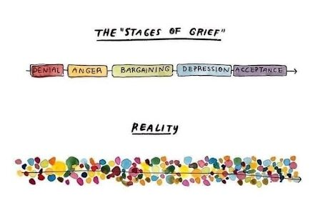
Common Family Responses: Grief
Psychosis can be an unexpected shock to the whole family and can bring up a range of emotions, including grief over unexpected life changes. All of these emotions are a byproduct of caring and love.

Slide 116

Turning down the heat
Sometimes, when family members are just beginning to understand psychosis, they may see their loved one's behaviors as intentional and react with criticism, fear, or anger. Other times, family members' emotions can run high in attempts to protect their loved one. An environment where emotions are running high much of the time can lead to poorer treatment outcomes, higher rates of relapse, and increased severity of symptoms for individuals with psychosis.
Goal: Take some of the emotional heat out of the environment. Put a damper on the intensity. Reduce the stress load at home.

Slide 117
Communication Tools and Tips

Slide 118
Family Guidelines (Part 1)
1. Believe in your power to affect the outcome: you can!
2. One step at a time.
3. Consider using medication if your psychiatric care provider recommends it.
4. Reduce stresses and responsibilities for a while.
5. Use the symptoms as indicators.
6. Anticipate life stresses.
7. Keep it calm.
8. Give each other space.
9. Set a few simple limits.
10. Accept what you cannot change.

Slide 119
Family Guidelines (Part 2)
Keep it simple.
Carry on business as usual.
Solve problems step by step.
Keep a balanced life and balanced perspective.
Avoid alcohol and substance use/misuse.
Explain your circumstances to your closest friends and relatives and ask them for help and to stand by you.
Don’t move abruptly or far away until stability returns.
Attend multi-family groups or single-family sessions.
Follow the recovery plan.
KEEP HOPE ALIVE!

Slide 120
Family Guidelines Activity
Break into groups of 2-3, preferably partnering with people outside of your family
Each group will receive a scenario card and Family Guidelines Sample Definitions
Discuss with your group and identify 1-2 family guidelines you might use in this situation and how it might be applied.
Choose someone to share with the group
Notes:
Scenario cards can be found at the end of this powerpoint – print that slide out, cut each scenario out, and use those to pass around.

Slide 121
Setting the Stage for Recovery…
Sometimes it can be easy to want to focus on changing someone’s thoughts and feelings when they are experiencing psychosis. However, this generally tends to end up causing more relationship distance, tension, and conflict. Instead, it can often be more helpful to look at how to change external factors instead of internal factors.

Slide 122
Partnering Together to Reduce Stress at Home
Instead of trying to change someone’s internal experiences, we encourage families to focus on ensuring that there is the best kind of environment to support recovery. This could include:
Biological or physical health strategies (taking medications as prescribed, maintaining a balanced diet, integrating physical movement into routines, etc.)
Social strategies (spending time with friends and family in laid-back ways, taking part in enjoyable activities, attending MFG or other groups offered by the team, etc.)
Communication and relationship strategies (managing stress, build strong communication skills, providing support to each other etc.)
Environmental strategies (ensuring there are safe and private spaces to go to when overwhelmed, reducing noise levels or the brightness of lights, etc.)
Learn and use the 'Problem-Solving Method’ discussed later in this presentation

Slide 123

Being Patient:
Pace of Recovery
Recovery from a first episode of psychosis (FEP) is a gradual, highly individual process that generally takes several months to a few years, rather than a rapid event.
While recovery can be slow, most individuals return to their daily lives and achieve a fulfilling, stable, and productive life.
Initial Phase: Acute symptoms typically begin to subside with treatment within 4–6 weeks to 3 months.
Early Recovery: This period focuses on stabilizing symptoms, finding the right medication and dosage, and beginning to resume daily activities.
Long-Term Recovery: For some, recovery is more of a long-term process of rebuilding and establishing stability.

Slide 124
LEAP: A Concrete Communication Strategy
It can sometimes be difficult for young person and their family/supports to agree on what the problem is. This can often lead to tension in the relationship or even conflict and fighting. The next slide shows a strategy for coming together to communicate more effectively. The goal is not to agree on everything but instead build shared understanding and find a goal to work on together.

Slide 125
The LEAP Method by Xavier Amadour
LISTEN: set aside judgement or need for winning the other person over to your “side.” Keep an open mind and focus on the other person’s experience and perspective, even if you don’t agree or even understand. Reflect back to them what you heard them say to show them you really listened.
EMPATHIZE: after hearing each other’s perspectives, recognize that everyone has a unique experience of the situation. Again – we aren’t trying to prove that one person is right or wrong, instead we just want to reach a place of understanding and empathy for one another.
AGREE: this stage is not about agreeing with each other on everything. Instead, work together to find one thing that you can agree you would like to be going better. It may not be the other person’s top priority, but it is a starting place to rebuild a place of connection and collaboration.
PARTNER: work together to build a basic, achievable plan to address the agreed upon issue. Remember – this isn’t about trying to fix everything in one go, it’s about working together to take the first steps toward a solution.

Slide 126
Breakout Groups

Slide 127
Breakout Groups
PRESENTERS: This is optional and can be amended based on context
Break the group into two sub-groups:
  EASA Participants and half of team in one room
  EASA family members/supports and rest of team in another room
Plan for 30 minutes in these subgroups.

Slide 128
Breakout for Caregivers and Siblings: Strategies for Stress Reduction
Anosognosia 101
LEAP
Finding people who understand
Sibling Questions and Resources

Slide 129
Breakout Session for Caregivers and Siblings:
Anosognosia 101 and Introduction to LEAP Method
Activity Part 1 : Pair up. Convince partner that (it's raining when the sun is shining; their eyes are brown when they are blue...). Share impressions.
Videos https://leapinstitute.org/free-leap-videos/
When A Loved One Refuses Treatment (4 + minutes)
Pills in the Trash (2 parts – 7 + minutes)
Pause between clips and talk about impressions.
Activity Part 2: Pair up with the same partner. Re-do Activity 1 keeping LEAP principles in mind. Share impressions.

Slide 130

Breakout for Caregivers and Siblings: Communication Strategies (LEAP)
Strongly recommend caregivers GET THIS BOOK!
Listen – Empathize – Agree – Partner

Slide 131
Breakout for Caregivers and Siblings:
General Communication Tips
Be aware of the level of your own emotions and try to maintain a low-stress environment at home. Symptoms of psychosis can make people much more sensitive to emotional tones and stimulation.
Be concrete and specific. Instead of “please help around the house,” try “Will you please do the dishes and vacuum the living room?”
Take care to not overwhelm. You may have to speak in shorter sentences, give directions step-by-step, repeat statements, or check in more frequently to ensure there is shared understanding. Instead of “please clean your room,” try “please make your bed… okay now pick up your dirty clothes… now take out the dirty dishes…”
After you speak, give the person plenty of time to digest the information and respond. Wait, and try not to fill the silence or overexplain.
Be careful about word choice to avoid communicating judgment. Avoid using medical language and medical labels.
Look for the positive. Provide consistent, sincere praise and positive feedback. Recognize the “wins,” no matter how small they may seem!
Be aware of your body language. Take a breath.

Slide 132
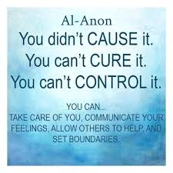
Breakout for Caregivers and Siblings:
The 3 C's

Slide 133
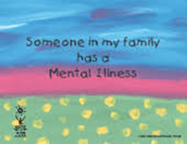

Breakout for Caregivers and Siblings:
FAQs and Resources for Siblings
"When Your Brother or Sister Has Psychosis": https://www.heretohelp.bc.ca/sites/default/files/when-your-brother-or-sister-has-psychosis.pdf
EASA Sibling Support Booklets: https://easacommunity.org/pro-resource/easa-sibling-support-booklets/

Slide 134
Discussion Activity
What is one thing you want your loved one to know?
Everyone shares with each other and agrees on 1-2 things to share. Assign someone to report these with the larger group, ensuring that everyone feels comfortable with what will be shared.

Slide 135
Breakout for Participants:
Strategies for Stress Reduction and Symptom Management
PRESENTERS: Refer to Navigate Family Manual Resource linked at the end of this presentation for page numbers listed below
Icebreaker Activity for participants
Rate your stress activity around Life Events/Daily Hassles (p. 142-143)
Stress reduction exercises:
  Relaxation Techniques (p. 149 – 151)
  Distraction Techniques
Art project

Slide 136
Breakout for Participants:
Icebreaker
PRESENTER: Choose one of the ideas below or create your own!
Rock, Paper, Scissors Tournament
Share something you’re proud of
“One Word at a Time”: groups must work together to create a sentence by contributing one word each while going round the circle. Start by giving a general topic or a guiding word to continue the sentence in a way that makes sense and is likely to result in a complete sentence.
Draw My Thought: pair up participants and provide one sheet of paper and one pencil per pair. One person will think of a basic image and tell the other how to draw it by saying things like “draw a curved line that connects to the flat line on the bottom,” without giving away what the object is.

Slide 137
Identifying Stress
PRESENTERS: review these materials and work through them with participants
Rate your stress activity around Life Events/Daily Hassles (p. 142-143)
  Navigate Family Education Program https://navigateconsultants.org/2020manuals/family_2020.pdf

Slide 138
Breakout for Participants:
Examples of Relaxation Techniques
PRESENTERS: Briefly introduce these relaxation techniques. Pick 3 to engage the group in
4-7-8 Breathing: Inhale for 4 seconds, hold for 7, and exhale for 8 seconds to calm the nervous system.
Progressive Muscle Relaxation (PMR): Systematically tensing and then relaxing muscle groups from feet up to the head to identify and release physical tension.
Autogenic Training: Repeating calming phrases like "my arms are heavy" combined with visualization to induce relaxation.
Guided Imagery: Mentally visualizing a safe, peaceful place (e.g., a beach) and engaging all senses to shift focus away from distressing thoughts.
Applied Relaxation: Using a cue word (like "relax" or "calm") while exhaling to quickly reduce tension.
Mindfulness-Based Relaxation: Observing anxious thoughts or voices without judgment and bringing focus back to the breath, often using apps.
Physical Relaxation Aids: Using tools like bubbles to encourage deep breathing or practicing yoga to combine movement with mindfulness.

Slide 139
Breakout for Participants:
Examples of distraction techniques for coping with symptoms
Sensory and Physical Activities:
  Engaging in Hobbies: Playing an instrument, painting, gardening, or building models.
  Physical Exercise: Walking, running, or working out to change physical energy.
  Using Comforting Items: Looking at photos of loved ones or special places.
  Temperature Regulation: Using cold (like ice) to break the cycle of distressing thoughts.
Cognitive and Mental Distractions:
  Mental Arithmetic: Counting backward by 7s from 100 or performing simple calculations.
  Memory Games: Reciting lyrics to a favorite song or visualizing a detailed, peaceful scene.
  Reading/Writing: Reading magazines, books, or writing down thoughts to process them.
Social and Passive Distractions:
  Socialization: Calling a friend or talking to a family member.
  Media Consumption: Watching TV, movies, or YouTube videos.
  Indulgence: Cooking a favorite meal or, for some, using smoking as a temporary distraction.
Targeted Symptom Coping (Voices/Thoughts):
  Audio Focus: Using headphones to listen to music or podcasts to drown out auditory hallucinations.
  Refocusing/Naming: Actively looking around and naming objects to stay grounded in reality.
  Subvocalization: Humming or talking quietly to oneself to reduce the impact of internal voices.
Notes:
PRESENTERS: Ask group to brainstorm techniques they use to cope with symptoms. Then connect their ideas to this list.

Slide 140
Activity
Art project and prompt about how can family (or those in the other room) support you better? What's one thing you would want them to know? Come back together as a group and share what you drew.
Assign someone to report out some themes that came up from the group, ensuring that everyone feels comfortable with what will be shared.
PRESENTERS: This can also be done conversationally, having ideas added to a large sticky note or shared paper

Slide 141
Problem-Solving Model
Family Psychoeducation Intervention

Slide 142
How to get involved in structured Family Psychoeducation – you have taken the first step by being here today!
Attend First Group "Getting to Know You"
Attend Second Group "How has mental health impacted your life" or "What brought you to EASA"
Attend Third and Ongoing Structure Problem Solving Groups (Multi-Family Group or single-family sessions) for the duration of your time in the program*. New group members are welcomed as they enter the program.
Attend "Joining Sessions" with EASA Staff
Attend Family Psychoeducational Workshop
*Some EASA programs permit individuals, their family members and supports to continue attending MFG after graduation from the program

Slide 143
Joining Sessions
"Joining means to connect, build rapport, convey empathy, and establish a collegial alliance"
Participant and/or family members who will be joining the multi-family groups or single-family sessions will meet with the facilitators to:
Be introduced to facilitators
Review participants and/or family's strengths and goals
Review information about the educational workshop, problem-solving method and answer questions
Support participant and family with what to expect at the 1st, 2nd and 3rd and beyond sessions

Slide 144
1st and 2nd Groups: What to expect
1st Group: "Getting to Know You"
Join the Multi-Family Group/single-family session for the first time
Socialize with facilitators and other families to feel more comfortable
2nd Group: "How has mental health impacted your life?" or "What brought you to join this program?"
Join the Multi-Family Group/single-family session for the second time
Personal stories are shared in the group, including from facilitators

Slide 145
3rd and Ongoing Structure Problem Solving Method
Multi-Family Group (MFG) or Single-Family Intervention (SFI)
 | MFG | SFI
1. Socializing with families and consumers | 15 m. | 10 m.
2. A Go-around, reviewing— The week’s events Relevant biosocial information Applicable guidelines | 20 m. | 15 m.
3. Selection of a single problem | 5 m. | 5m.
4. Formal Problem-solving Problem definition Generation of possible solutions Weighing pros and cons of each Selection of preferred solution Delineation of tasks and implementation | 45 m. | 25 m.
Socializing with families and consumers | 5 m. | 5m.
Total: | 90 m. | 60 m.

Slide 146
Who Might Benefit from the MFG Problem-Solving Model: Everyone!
Especially useful for families experiencing:
Conflict or high anxiety
Instability, high symptom acuity, or family distress
Disengagement and lack of participation in treatment
Substance misuse
Feeling stuck
Desire to support others in similar situations
Loss of hope

Slide 147
Benefits of the Problem-Solving Method
Problem-Solving Method can…
Increase of understanding of symptoms
Increase skill building in life, communication, problem solving, intervening to prevent worsening symptoms, remembering to identify and celebrate successes
Help share family sense of burden– and improves family/supporters' engagement in treatment/healing/recovery
Reduce likelihood of significant relapse and potentially avoidable hospitalizations
Encourage community participation in school, work, community, family, social relationships and daily life activities (improved employment outcomes)
Multi-Family Group...
Reduces social isolation
Promotes socialization and friendships in and outside of group

Slide 148
Single Family Options
Not able to make it to the Multi-Family Group right now?
Participants and/or families can meet with the facilitators to utilize the problem-solving format in a Single-Family Format.
Utilizes the same problem-solving model
Offers shared decision-making opportunities
Provides ongoing and specific information
PRESENTERS:
List other opportunities to meet other families and connect if they will not be attending MFG groups

Slide 149
Lived Experience
PRESENTERS: Include story, video, quote, etc. from someone with lived experience related to family engagement and involvement, especially groups. Consider contacting current participants, graduates, and current/past family members.

Slide 150
Discussion
PRESENTER: Choose one or all depending on time and group engagement
What did you learn/take away from today?
What do you see as potentially most helpful?
What is one thing you will do differently after learning what you have today?

Slide 151
Conclusion
There are many paths to recovery, and they are unique to everyone. While taking part in the program, you have a strong support network who will assist you to get where you want to be and help you set yourself up for ongoing success.
As you move through the program, talk to your team about any questions, concerns, or feedback you might have for them. They are here to help and partner with you and your family. You aren’t in this alone!

Slide 152
Resources/References

Slide 153
Local Resources
Local NAMI chapter
24/7 Crisis lines
Drop-in centers
Team contact info

Slide 154
Resources for Family Members/Supports
Support Groups:
  MFG!
  Local NAMI group https://www.nami.org/
  FFLC group and Newsletter
EASA Website https://easacommunity.org/
  Family & Friends Leadership council https://easacommunity.org/family-and-friends-leadership-council/
  EASA Family and Friends Manual https://easacommunity.org/wp-content/uploads/2023/09/EASA-Family-and-Friends-Manual.pdf
  EASA Participant Manual https://easacommunity.org/wp-content/uploads/2023/09/EASA-Participant-Manual.pdf
EASA's "Supporting the Sibling of Individuals with Psychosis" booklet https://easacommunity.org/pro-resource/easa-sibling-support-booklets/
Navigate Family Education Program https://navigateconsultants.org/2020manuals/family_2020.pdf
Dealing with Psychosis workbook (free): https://www.dshs.wa.gov/sites/default/files/BHSIA/FMHS/Dealing%20with%20Psychosis-full-workbook.pdf
A Sibling’s Guide to Psychosis: Information, Ideas and Resources (2005). Age 12 and up https://ontario.cmha.ca/wp-content/uploads/2016/11/ASiblingsGuideToPsychosis.pdf
Someone In My Family Has A Mental Illness (2000). Age 4 and up https://famillemaladiementale.wordpress.com/wp-content/uploads/2015/11/someone-in-my-family-has-a-mental-illness-workbook.pdf
Psychosis Reach class https://www.psychosisreach.org/
Books:
  Back to Life, Back to Normality, by Douglas Turkington et al.
  I'm Not Sick, I Don't Need Help, by Dr. Xavier Amador
  Living Well with Psychosis, by Aaron P. Brinen
  When Life Hits Hard, by Russ Harris
  Loving Someone with a Mental Illness or History of Trauma: Skills, Hope, and Strength for Your Journey by Michelle D. Sherman
  I’m Not Alone: A Teen’s Guide to Living with a Parent Who Has a Mental Illness or History of Trauma by Michelle D. Sherman
Podcasts:
  Schizophrenia, Three Mom's in the Trenches (YouTube)
Mental Health America. (n.d.). HIPPA: What Are a Caregiver’s Rights? https://mhanational.org/resources/hipaa-what-are-a-caregivers-rights/

Slide 155
References
Ahrens J., Cassidy C.M., Ford S.D., Khan AR, Palaniyappan L., Rabin R., Reese D., Schaefer B., Tibbo P. (2025). Convergence of cannabis and psychosis on the dopamine system. JAMA Psychiatry, 82(6), 609–617. https://doi.org/10.1001/jamapsychiatry.2025.0432
Ajnakina, O., Cullinane M., Gaughran F., Lally, J., Murray R., Murphy K.C., Stubbs B. (2018). Remission and recovery from first-episode psychosis in adults: systematic review and meta-analysis of long-term outcome studies​. British Journal of Psychiatry, 211(6), 350-358. https://doi.org/10.1192/bjp.bp.117.201475
Amador X. (2020). I’m not sick, I don’t need help! How to help someone accept treatment. Vida Press.
American Psychiatric Association. (2022). Diagnostic and statistical manual of mental disorders (5th ed., text rev.). https://doi.org/10.1176/appi.books.9780890425787
Bearden C.E. (2025). The link between cannabis and psychosis in teens is real. Scientific American. Retrieved April 7. 2026, from https://www.scientificamerican.com/article/the-link-between-cannabis-and-psychosis-in-teens-is-real/
Brabban, A., & Turkington, D. (2002). The search for meaning: Detecting congruence between life events, underlying schema and psychotic symptoms. In A. P. Morrison (Ed.), A Casebook of Cognitive Therapy for Psychosis (1st ed., pp. 59–75). Routledge.
British Columbia Schizophrenia Society. When your brother or sister has psychosis. Retrieved April 7, 2026, from https://www.heretohelp.bc.ca/sites/default/files/when-your-brother-or-sister-has-psychosis.pdf
Cather C., Gingerich S., Gottlieb J.D., Meyer P.S., Mueser K.T., Penn D.L. (2020) Navigate Family Education Program. (2020). Retrieved April 7, 2026, from https://navigateconsultants.org/2020manuals/family_2020.pdf
Chung, Y. C., Kang, S. H., Kim, E., Kim, S. H., Kim, S. W., Kim, W. S., Lee, B. J., Lee, B. M., Lee, K. Y., Lee, S. H., Li, L., Rami, F. Z., Won, S. H., Yu, J. C. (2022). Three-year outcomes and predictors for full recovery in patients with early-stage psychosis. Schizophrenia (Heidelberg, Germany), 8(1), 87. https://doi.org/10.1038/s41537-022-00301-4
Deegan, P. (2026). Free Resources/Posters. Retrieved April 7. 2026, from https://www.patdeegan.com/resources
Ehman, T., Hanson L., Bilsker D., Strong, T. YagerJ., Dalzell K., Zitko D. (2012) Dealing with Psychosis: A Toolkit for Moving Forward with Your Life. British Columbia Ministry of Health & Fraser Health. Retrieved April 7, 2026, from https://www.dshs.wa.gov/sites/default/files/BHSIA/FMHS/Dealing%20with%20Psychosis-full-workbook.pdf
Family Services of the North Shore. (2000) Someone in My Family Has a Mental Illness. (2000). Retrieved April 7, 2026, from https://famillemaladiementale.wordpress.com/wp-content/uploads/2015/11/someone-in-my-family-has-a-mental-illness-workbook.pdf
Giannopoulou I., Georgiades S., Stefanou M., Spandidos D. & Rizos E. (2023). Links between trauma and psychosis: Review. Therapeutic Medicine, 26(2), 386. https://doi.org/10.3892/etm.2023.12085
Hafner H., Maurer K. & Loffler (2006). Early detection of schizophrenia: current evidence and future perspectives. WorldPsychiatry: official journal of the World Psychiatric Association (WPA). 5(3), 130-138. https://pubmed.ncbi.nlm.nih.gov/17139339/
Inyang, B., Gondal, F. J., Abah, G. A., Minnal Dhandapani, M., Manne, M., Khanna, M., Challa, S., Kabeil, A. S., & Mohammed, L. (2022). The role of childhood trauma in psychosis and schizophrenia: A systematic review. Cureus. https://doi.org/10.7759/cureus.21466
Jewell T.C., Downing D., McFarlane W.R. (2009). Partnering with families: multiple family group psychoeducation for schizophrenia. Clinical Psychology, 65(8), 868-878. https://doi.org/10.1002/jclp.20610
Lane County Early Assessment and Support Alliance. (2026). What is clinical high risk for psychosis?. Retrieved April 7. 2026, from https://www.lanecountyeasa.org/what-is-chrp
Luhrman T. M., Osei A., Padmavati R., & Tharoor H. (2015). Differences in voice-hearing experiences of people with psychosis in the U.S.A, India and Ghana: interview-based study. The British journal of psychiatry: the journal of mental science, 206(1), 41–44. https://doi.org/10.1192/bjp.bp.113.139048
Lumen Learning. (2020). Lifespan Development. Retrieved April 7. 2026, from https://courses.lumenlearning.com/wm-lifespandevelopment/chapter/periods-of-human-development/ ​

Slide 156
References, cont’d
Maijer K., Hayward M., Fernyhough C., Calkins M.E., Debbané M., Jardri R., Kelleher I., Raballo A., Rammou A., Scott J.G. & Shinn A.K. (2019). Hallucinations in children and adolescents: an updated review and practical recommendations for clinicians. Schizophrenia bulletin. Feb 1;45 (Supplement_1): S5-23. https://pubmed.ncbi.nlm.nih.gov/30715540/
McDonald A., Kurdyak P., Rehm J. Roerecke M. & Bondy S.J. (2024). Psychological Medicine. Aug:54(11)2926-2936 DOI: 10.1017/S0033291724000990
McFarlane W. (2016): Family Interventions for Schizophrenia and the Psychoses: A Review. Family Process. 55 (3) 460-482. https://doi.org/10.1111/famp.12235):​
McGrath JJ, Saha S, Al-Hamzawi A, et al. Psychotic Experiences in the General Population: A Cross-National Analysis Based on 31 261 Respondents From 18 Countries. JAMA Psychiatry. 2015;72(7):697–705. doi:10.1001/jamapsychiatry.2015.0575
Mental Health America. (n.d.). HIPPA: What Are a Caregiver’s Rights? https://mhanational.org/resources/hipaa-what-are-a-caregivers-rights/
Mirza A., Birtel M.D., Morrison A.P. & Pyle M. (2019). Cultural Differences in Psychosis: The Role of Causal Beliefs and Stigma in White British and South Asians. Sage Journals. 50(3) https://doi.org/10.1177/0022022118820168
Mulder S. & Lines E. (2005). A Sibling’s Guide to Psychosis: Information, Ideas and Resources. Canadian Mental Health Association. https://ontario.cmha.ca/documents/a-siblings-guide-to-psychosis-information-ideas-and-resources/
Myran, D.T., Harrison L. D., Pugaliese, M., Solmi, M., Anderson, K.K., Fiedorowicz J.G., Perlman, C.M., Webber C., Finkelstein, Y., Tanuseputro P. (2023). Transition to Schizophrenia Spectrum Disorder Following Emergency Department Visits Due to Substance Use With and Without Psychosis. JAMAPsychiatry;80(11):1169-1174. https://pubmed.ncbi.nlm.nih.gov/37755727/
Park, W. (2025, September 3). The places where ‘hearing voices’ is seen as a good thing. BBC News. https://www.bbc.com/future/article/20250902-the-places-where-hearing-voices-is-seen-as-a-good-thing​
Supporting Families by Psychoeducation in Psychotic Illness. (2026). Hope for carers: family psychosis education program. https://familypsychosis.com/ ​
Sleep Health Foundation. (2024). Schizophrenia and sleep. Jan12. https://www.sleephealthfoundation.org.au/sleep-topics/schizophrenia-and-sleep
Simpson R. et al. (2018). Young Adult Development Project. Massachusetts Institute of Technology. https://hr.mit.edu/static/worklife/youngadult/changes_ya.html
Staines, L., Healy, C., Murphy, F., Byrne, J., Murphy, J., Kelleher, I., Cotter, D., & Cannon, M. (2023). Incidence and Persistence of Psychotic Experiences in the General Population: Systematic Review and Meta-Analysis. Schizophrenia bulletin, 49(4), 1007–1021. https://doi.org/10.1093/schbul/sbad056 Starzer M., Nordentoft M. & Hjorthoj C. (2017). Rates and Predictors of Conversion to Schizophrenia or Bipolar Disorder Following Substance-Induced Psychosis. American Journal of psychiatry. 175(4): appi.ajp.2017.1 https://psychiatryonline.org/doi/10.1176/appi.ajp.2017.17020223
The LEAP Institute https://leapinstitute.org/
Turkington, D., Lebert L. & Spencer H. Auditory hallucinations in schizophrenia: helping patents to develop effective coping strategies. BJPsych Advances (2016), vol. 22, 391–396 doi: 10.1192/apt.bp.115.01521 https://www.cambridge.org/core/services/aop-cambridge-core/content/view/F35C4FD6D8702584A860FEB9978EA503/S2056467800002000a.pdf/auditory_hallucinations_in_schizophrenia_helping_patients_to_develop_effective_coping_strategies.pdf
Yale School of Medicine. (2024). Behind the Smoke: Unmasking the Link Between Cannabis and Schizophrenia. Aug. https://medicine.yale.edu/news-article/behind-the-smoke-unmasking-the-link-between-cannabis-and-schizophrenia/
Yates K, Lång U, Cederlöf M, et al. Association of Psychotic Experiences With Subsequent Risk of Suicidal Ideation, Suicide Attempts, and Suicide Deaths: A Systematic Review and Meta-analysis of Longitudinal Population Studies. JAMA Psychiatry. 2019;76(2):180–189. doi:10.1001/jamapsychiatry.2018.3514

Slide 157
References, cont’d
Ice Breaker sites:
https://www.sessionlab.com/blog/icebreaker-games/​
https://weand.me/2024/09/03/no-prep-icebreakers-for-adults/
Video clips
Cannabis & Psychosis. (2020). Schizophrenia Society of Canada. https://www.youtube.com/watch?v=VD2AvIXVgOw
EASA Program Video: Marion County Health Promotion & Prevention. https://www.youtube.com/watch?v=lUT2SUuw3z4&t=15s
Lady Gaga Diagnosed with Psychosis and Lost Touch with Reality. 2025. https://www.youtube.com/watch?v=PFuCSwbJ9D8
Leap Institute videos https://leapinstitute.org/free-leap-videos/
Pete Davidson (Short): Weed Gave Me Psychosis! https://www.youtube.com/shorts/QATThGamIwk

Slide 158
Family Guidelines Activity Example Scenarios
Example 1: James’ parents have asked him to do the dishes three times today. James has stated he does not feel like doing them right now and will do them tomorrow. However, it is important to James’ mom that the dishes are done every day.
Example 2: Selena’s dad is worried about her recent increase in isolation. He has tried to get her to come out of her room, but she is refusing and saying she just wants to be alone. He is concerned that this is a sign that her psychosis may be returning.
Example 3: Max and their sibling have begun fighting over who gets to control the TV. Max wants to play their video games, but his sister wants to watch her favorite show. These fights have started to get more intense and can sometimes end in shouting matches where their parents have to get involved.
Example 4: Sophie’s grades have recently begun to drop. School is very important in her household, and she knows that she is expected to maintain an A/B average and has been getting stressed about doing well enough. Sophie’s mom is trying to be understanding that she is having a harder time but still thinks Sophie could spend more time with the material to improve her grades.

